Slide 1

SLAM WITH D435
By Alex Scherbakov

Slide 2

Outline
D435 and stereo depth vision
ROS
SLAM

Slide 3
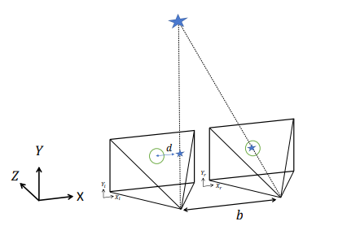
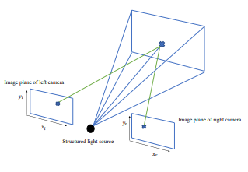
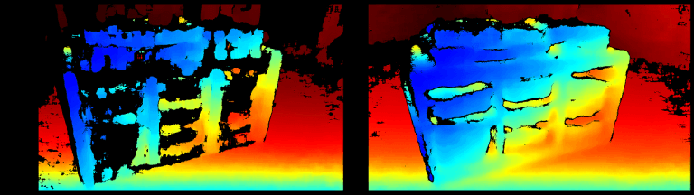
Passive vs Active Stereo
Stereo vision
Active stereo vision

Slide 4
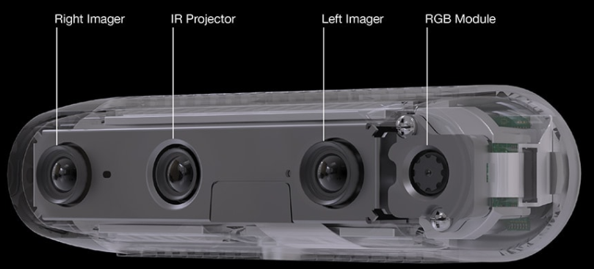
Depth Camera D435

Slide 5
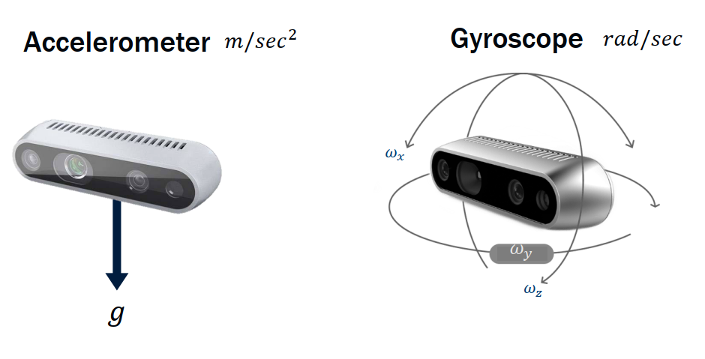
Inertial Measurement Unit D435i

Slide 6
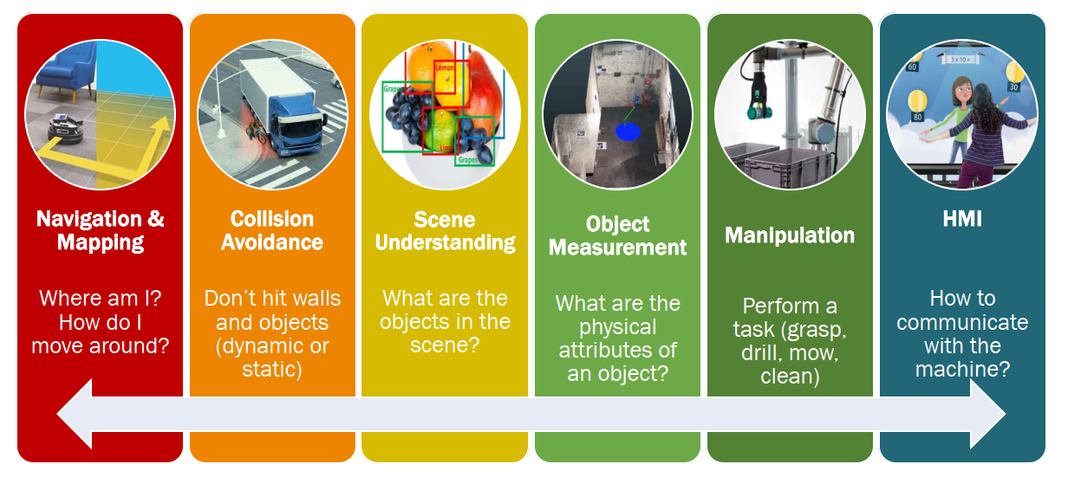
Applications

Slide 7
Example – D435
RealSense - Viewer

Slide 8

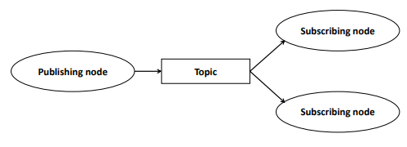
ROS - Robot operating system

Slide 9
Example – D435 & ROS
roscore
&
rviz
&
roslaunch realsense2_camera rs_camera.launch

Slide 10
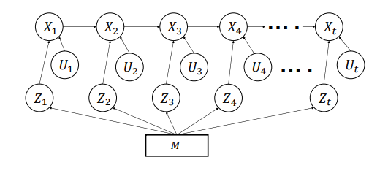
SLAM - simultaneous localization and mapping

Slide 11
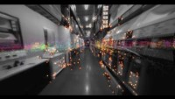
SLAM - simultaneous localization and mapping
Localization & Mapping | SLAM with Intel D435i

Slide 12
Example – D435 & ROS & SLAM
Putting Everything Together
Roscore
&
roslaunch realsense2_camera opensource_tracking.launch

Slide 13
Thanks for listen

